Slide 1
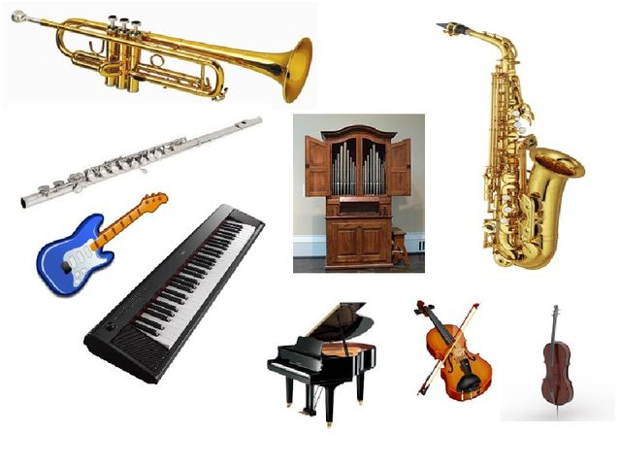
Unit 5 : Creativity
Theme: Music
Grade:5

Slide 2
Learning objectives
5.S7 appropriate subject-specific vocabulary and syntax to talk about a limited range of general topics
Lesson objectives
name , define and understand the names of musical instruments
5.R2 understand with little support specific information and detail in short, simple texts on a limited range of general and curricular topics
5.W1 plan, write, edit and proofread work at text level with support on a limited range of general and curricular topics
use and differentiate words to make sentences using topical vocabulary
plan, generalize and produce their own short story

Slide 3
name and use subject- specific vocabulary on topic
understand the subject- specific vocabulary on topic
write and tell about musical instruments
Assessment criteria
To develop the students ’mental power inner hearing ,musical memory and recognition .To encourage students to use music to communicate with their classmates as other kind of communication media
To bring up the culture of personality through music (“Mangilik Yel”,6)
Value links
Cross curricular links
Music
ICT skills
Video
Presentation

Slide 4
Planned Activities
Speaking
Reading
Writing
Brainstorming
Video clip
“Kinds of music “
Teacher asks questions for students to identify their interests music and for developing of oral speech
Pre-reading
“Guess and match the types of musical instruments”
While-reading
Read the text and complete the chart below
Post-reading
Ask the following questions then make dialogues with your partners
Complete the crossword writing the name of mystery words

Slide 5
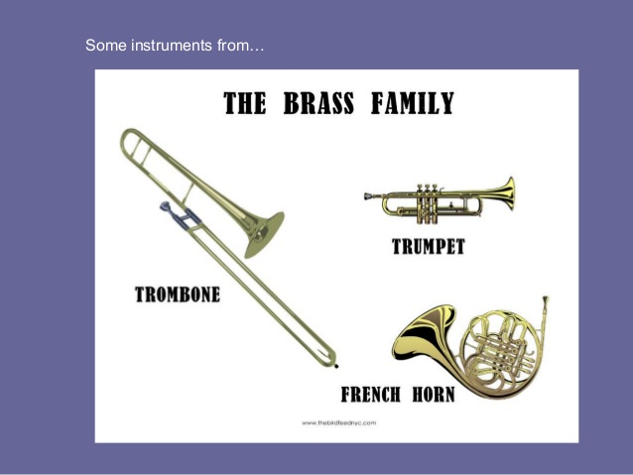
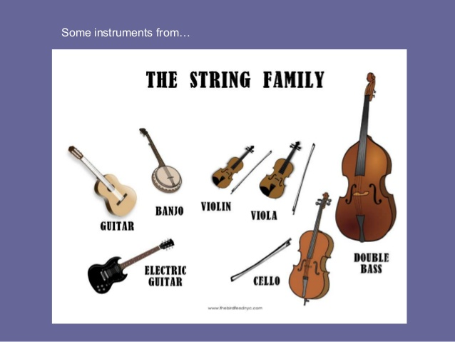
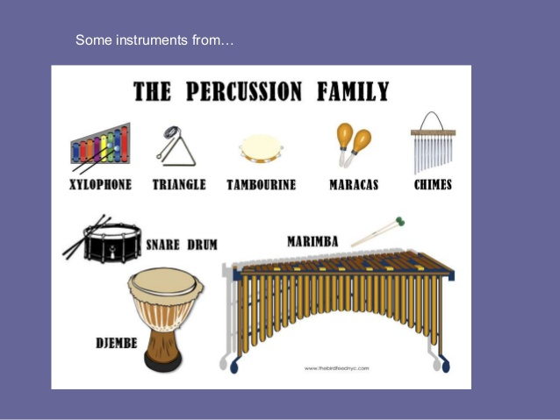
Activity: Classification
Learners classify musical instruments according to the group.

Slide 6
Group”Dombyra”
Complete the crossword and find the mystery world
Group“Guitar”
Learners make-up short dialogue on the theme
“My favorite musical instrument”
Group“Piano”
Learners make-up short text on the theme “My favorite singer”
Differentiation by tasks

Slide 7
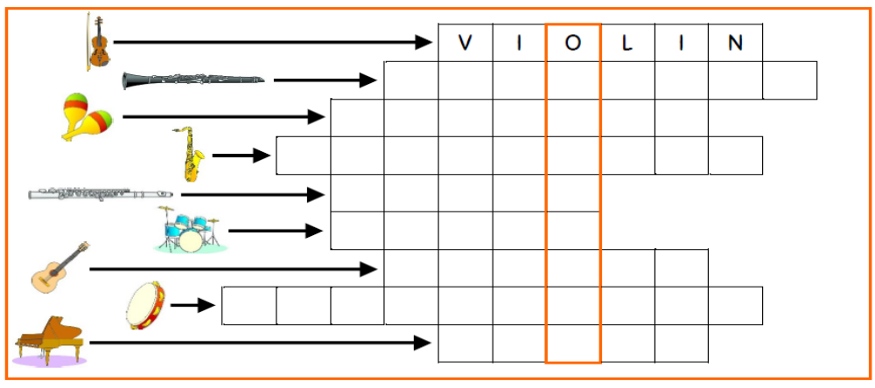
Crossword
Complete the crossword and fine the mystery word
Descriptor : A learner
- completes the crossword
- finds the mystery word
- write with grammatical

Slide 8

Brainstorming Activity 1
Video clip: “Kinds of music”
https://m.youtube.com/watch?v=wiF8YlKNx4g

Slide 9
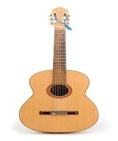


I have learnt…
I still want to know…
I didn’t understand
Feedback
Evaluation Final Self-Assessment Tick “+” or “-”
Can you… | + | -
identify and name 10-12 words about musical instruments
Understand with little support specific information and detail in short, simple texts tell about musical instruments
write the names of musical instruments
tell about musical instruments

